Slide 1
Syllabus
UNIT-I: Basics of python programming
Introduction: Introduction to computer system, algorithms and flowcharts, Ethics and IT policy in company, A Brief History of Python, Applications areas of python, The Programming Cycle for Python, Python IDE.
Elements of Python: Keywords and identifiers, variables, data types and type conversion, operators in python, Operator precedence and associativity, expressions in python, strings, Indexing and Slicing of Strings, Classes and object, constructor.

Slide 2
Syllabus
UNIT-II: Decision Control Statements
Conditional Statements: if statement, if-else statement, Nested-if statement and elif statements.
Loops: Purpose and working of loops, while loop, for loop, else with loop statement, Selecting an appropriate loop, Nested Loops, break, continue and pass statement.

Slide 3
Syllabus
UNIT-III: Function and Modules
Introduction of Function, calling a function, Function arguments, Mutability and Immutability, built in function, scope rules, Namespaces, Garbage Collection, Passing function to a function, recursion, Lambda functions, Map, filter, Reduce.
Modules and Packages: Importing Modules, writing own modules, Standard library modules, dir( ) Function, Packages in Python.

Slide 4
Syllabus
UNIT-IV: Basic Data structures in Python
Python Basic Data Structures: Sequence, Packing and Unpacking Sequences, Mutable Sequences, Strings, Basic operations, Comparing strings, string formatting, Slicing, Built-in string methods and function, Regular expressions, Lists, Tuples, Sets and Dictionaries with built-in methods, List Comprehension, Looping in basic data structures.

Slide 5
Syllabus
UNIT-V: File and Exception handling
Files and Directories: Introduction to File Handling, Reading and Writing files, Additional file methods, Working with Directories.
Exception Handling, Errors, Run Time Errors, Handling I/O Exception, Try-except statement, Raise, Assert.

Slide 6
Syllabus
UNIT-I: Basics of python programming
Introduction: Introduction to computer system, algorithms and flowcharts, Ethics and IT policy in company, A Brief History of Python, Applications areas of python, The Programming Cycle for Python, Python IDE.
Elements of Python: keywords and identifiers, variables, data types and type conversion, operators in python, Operator precedence and associativity, expressions in python, strings, Indexing and Slicing of Strings, Classes and object, constructor.

Slide 7
Syllabus
UNIT-II: Decision Control Statements
Conditional Statements: if statement, if-else statement, Nested-if statement and elif statements.
Loops: Purpose and working of loops, while loop, for loop, else with loop statement, Selecting an appropriate loop, Nested Loops, break, continue and pass statement.

Slide 8
Syllabus
UNIT-III: Function and Modules
Introduction of Function, calling a function, Function arguments, Mutability and Immutability, built in function, scope rules, Namespaces, Garbage Collection, Passing function to a function, recursion, Lambda functions, Map, filter, Reduce.
Modules and Packages: Importing Modules, writing own modules, Standard library modules, dir( ) Function, Packages in Python.

Slide 9
Syllabus
UNIT-IV: Basic Data structures in Python
Python Basic Data Structures: Sequence, Packing and Unpacking Sequences, Mutable Sequences, Strings, Basic operations, Comparing strings, string formatting, Slicing, Built-in string methods and function, Regular expressions, Lists, Tuples, Sets and Dictionaries with built-in methods, List Comprehension, Looping in basic data structures.

Slide 10
Syllabus
UNIT-V: File and Exception handling
Files and Directories: Introduction to File Handling, Reading and Writing files, Additional file methods, Working with Directories.
Exception Handling, Errors, Run Time Errors, Handling I/O Exception, Try-except statement, Raise, Assert.

Slide 11




Course Objective
In this semester, the students will
Study the basic of computers and algorithms.
Study the history of Python and Programming Cycle for Python.
Gain the understanding of the Python IDE and understand how to write Python Program.
Learn the elements of Python like Keywords and Identifiers, Variables, Data types and Operators.

Slide 12
Unit I Content
Introduction to computer system
Algorithms and flowcharts
Ethics and IT Policy in Company
A Brief History of Python
Applications areas of python
The Programming Cycle for Python, Python IDE
7. Elements of Python
Keywords and Identifiers
Variables
Data types and type conversion
Operators in Python
Operator precedence and associativity
Expressions in Python
Strings
Indexing and Slicing of Strings
Classes and Object
Constructor

Slide 13
Unit I Objective
In Unit I, the students will
Gain the understanding of computer system.
Study algorithms and flowchart.
Learn Ethics and IT policy in company.
Study history, applications areas, programming cycle for Python and Python IDE.
Study elements of Python.

Slide 14
Topis Prerequisite
Basic Understanding of terminology of digital computer.

Slide 15
Topic Objective
Topic : Introduction to computer system
In this topic, the students will gain the understanding of component of computer, working of its component, characteristics of computer.

Slide 16
Computer (CO1)
The term computer is derived from the term “compute”. Computer is a programmable electronic device that takes data and instruction as an input from the user and, process data, and provides useful information.
OUTPUT
INPUT
PROCESS
Data
Information
Instructions

Slide 17
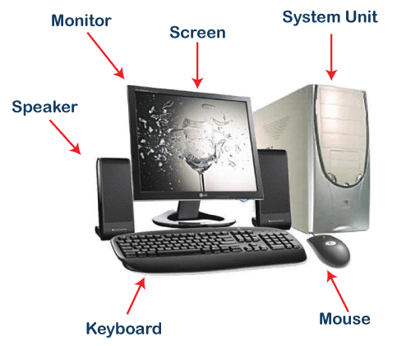
Computer (CO1)

Slide 18
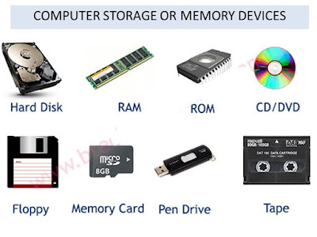
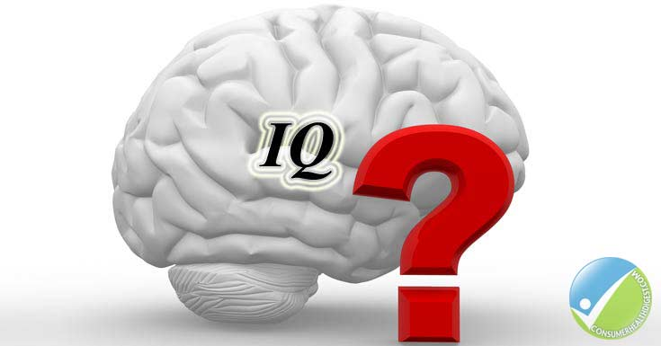
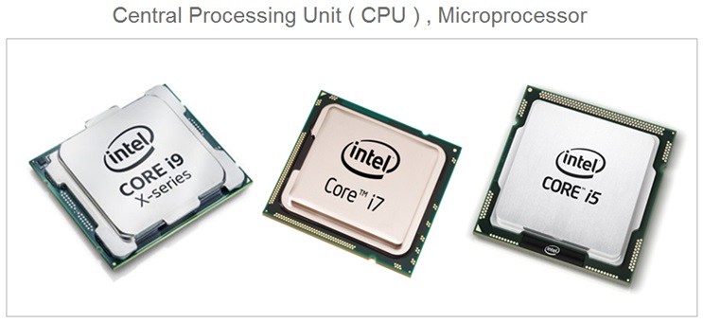

Characteristics of Computers (CO1)
Computers
Storage
Speed
Accuracy
Diligence
Versatility
No IQ/ No Feeling

Slide 19
Application of Computers (CO1)
Word Processing
Internet
Digital Audio/Video Compression
Desktop Publishing
Traffic Control
Retail Business
Hospitals
Business and Industry
Weather Forecasting
Education
Online Banking
Robotics
Expert Systems

Slide 20
Block Diagram of Digital Computers (CO1)
EXTERNAL STORAGE UNITS
Magnetic Tapes
Magnetic Disk
Input Unit
Memory Unit
Output Unit
Information or Result
Data
Arithmetic Logic Unit
Control Unit
CPU

Slide 21
Algorithm (CO1)
Algorithm is the well-defined computational procedures that takes some values or set of values as input, process it and produces some values or set of values as output.

Slide 22
Characteristics of Algorithm (CO1)
Input
It takes zero or more values as input.
Output
It produces one or more values as output.
Finiteness
It should terminate after finite number of steps.
Definiteness
Each instruction must be clear, precise and unambiguous.
Effectiveness
Each instruction must be very basic but essential so that it can be carried out using pen and paper.

Slide 23
Flowchart (CO1)
It is the pictorial representation of the algorithm.
It is used by programmer as a programming planning tool for organizing the sequence of steps necessary to solve the problem.
It is also known as the roadmap for programming.

Slide 24
Elements of Flowchart (CO1)
Picture | Name | Meaning
 | Ellipse/Oval | Start/End
 | Rhombus | Input and output
 | Rectangle | Data Processing
 | Diamond | Condition
 | Arrows | Movement or flow of operations

Slide 25
Algorithm and flowchart (CO1)
Write the algorithm and draw the flowchart to compute the sum of two numbers.
Write the algorithm and draw the flowchart to compute the sum and average of five numbers.
Write the algorithm and draw the flowchart to compute the area of triangle using heron’s formula.
Write the algorithm and draw the flowchart to compute the temperature in degree Fahrenheit when temperature in degree Celsius is given.
Write the algorithm and draw the flowchart to swap two numbers using 3rd variable.
Write the algorithm and draw the flowchart to swap two numbers without using 3rd variable.

Slide 26
Algorithm and flowchart(CO1)
Write the algorithm and draw the flowchart to check whether the number is odd or even.
Write the algorithm and draw the flowchart to compute the greater of two numbers.
Write the algorithm and draw the flowchart to compute the greatest of three numbers.
Write the algorithm and draw the flowchart to check whether the given year is leap year or not.
Write the algorithm and draw the flowchart to compute the sum of first N natural numbers.

Slide 27
Algorithm and flowchart(CO1)
Write the algorithm and draw the flowchart to compute the factorial of the given number.
Write the algorithm and draw the flowchart to compute the sum of digits of the given number.
Write the algorithm and draw the flowchart to compute the reverse of the given number. Also check the given number is in palindrome or not.
Write the algorithm and draw the flowchart to convert the decimal number to binary number.
Write the algorithm and draw the flowchart to convert the binary number to decimal number.

Slide 28
Algorithm and flowchart(CO1)
Write the algorithm and draw the flowchart to compute the factorial of the given number.
Write the algorithm and draw the flowchart to compute the sum of digits of the given number.
Write the algorithm and draw the flowchart to compute the reverse of the given number. Also check the given number is in palindrome or not.
Write the algorithm and draw the flowchart to convert the decimal number to binary number.
Write the algorithm and draw the flowchart to convert the binary number to decimal number.

Slide 29
Code of Ethics and Professional Conduct (CO1)
The Code is designed to inspire and guide the ethical conduct of all computing professionals, including current and aspiring practitioners, instructors, students, influencers, and anyone who uses computing technology in an impactful way.

Slide 30
Code of Ethics and Professional Conduct (CO1)
1. GENERAL ETHICAL PRINCIPLES
A computing professional should...
1.1 Contribute to society and to human well-being, acknowledging that all people are stakeholders in computing.
1.2 Avoid harm.
1.3 Be honest and trustworthy.
1.4 Be fair and act not to discriminate.
1.5 Respect the work required to produce new ideas, inventions, creative works, and computing artifacts.
1.6 Respect privacy.

Slide 31
Code of Ethics and Professional Conduct… (CO1)
2. PROFESSIONAL RESPONSIBILITIES
A computing professional should…
2.1 Strive to achieve high quality in both the processes and products of professional work.
2.2 Maintain high standards of professional competence, conduct, and ethical practice.
2.3 Know and respect existing rules pertaining to professional work.
2.4 Accept and provide appropriate professional review.

Slide 32
Code of Ethics and Professional Conduct… (CO1)
2. PROFESSIONAL RESPONSIBILITIES
2.5 Foster public awareness and understanding of computing, related technologies, and their consequences.
2.6 Access computing and communication resources only when authorized or when compelled by the public good.
2.7 Design and implement systems that are robustly and usably secure.

Slide 33
Code of Ethics and Professional Conduct… (CO1)
3. PROFESSIONAL LEADERSHIP PRINCIPLES
3.1 Ensure that the public good is the central concern during all professional computing work.
3.2 Manage personnel and resources to enhance the quality of working life.
3.3 Create opportunities for members of the organization or group to grow as professionals.

Slide 34
Code of Ethics and Professional Conduct (CO1)
4.1 Uphold, promote, and respect the principles of the Code
Programming Code of Ethics
Key points of proper conduct for Computer Programmers- A programmer must...
Never create or distribute malware.
Never write code that is intentionally difficult to follow.
Never write documentation that is intentionally confusing or inaccurate.
Never reuse copyrighted code unless the proper license is purchased, or permission is obtained.
.

Slide 35
Code of Ethics and Professional Conduct… (CO1)
Acknowledge (verbally and in source code comments) the work of other programmers on which the code is based, even if substantial changes are made.
Never intentionally introduce bugs with the intent of later claiming credit for fixing the bugs, or to stimulate the uptake of later versions.
Never write code that intentionally breaks another programmer's code for the purpose of elevating one's status.
Never hide known obstacles to a project's completion during any phase of development, especially the design phase.

Slide 36
Code of Ethics and Professional Conduct… (CO1)
Report any illegal activities of the employer.
Never falsely deny the presence of bugs.
Never reveal the secret corporate knowledge of an employer.
Never accept compensation from multiple parties for the same work unless permission is given.
Never conceal from the employer their financial interest in development resources.

Slide 37
Code of Ethics and Professional Conduct… (CO1)
Never maliciously injure the reputation of an employer or members of the development team.
Never take credit for another's work.
Never steal software, especially development tools.
Never install third-party applications without the user's permission.

Slide 38
IT Policy (CO1)
Companies provides and maintains technological products, services and facilities like Personal Computers (PCs), peripheral equipment, servers, telephones, Internet and application software to its employees for official use.
The Information Technology (IT) Policy of the organization defines rules, regulations and guidelines for proper usage and maintenance of these technological assets to ensure their ethical and acceptable use and assure health, safety and security of data, products, facilities as well as the people using them.
It also provides guidelines for issues like purchase, compliance, IT support and grievance redressal of the employees pertaining to technological assets and services used for office work.

Slide 39
IT Policy… (CO1)
Acceptable Use Policy
Security awareness
DR/BCP (Disaster Recovery, Business Continuity plan)
Change management.
Equipment Usage policy
PC standards
The Internet Usage Policy
Information security Policy
Email and chat Policy
The Software Usage Policy

Slide 40
Python Introduction (CO1)
Python Introduction (CO1)

Slide 41
Topic Objective
The students will study the history of Python and Programming Cycle for Python.
The students will gain the understanding of the Python IDE and understand how to write Python Programme.

Slide 42
Prerequisite and Recap
Basic knowledge of programming language.

Slide 43
Introduction (CO1)
What is Python Language?
Python is a high-level general-purpose, interpreted, interactive, object-oriented and reliable language having wide range of applications from Web development, scientific and mathematical computing to desktop graphical user Interfaces.
The syntax of the language is clean, and length of the code is relatively short.
It allows to think about the problem rather than focusing on the syntax

Slide 44
A Brief History of Python (CO1)
Guido Van Rossum was doing its application-based work in December of 1989 at Centrum Wiskunde & Informatica (CWI) which is situated in Netherland.
It was started firstly as a hobby project because he was looking for an interesting project to keep him occupied during Christmas.

Slide 45
A Brief History of Python Cont…(CO1)
The programming language which Python is said to have succeeded is ABC Programming Language.
He had already helped to create ABC earlier in his career and he had seen some issues with ABC but liked most of the features.
After that what he did as very clever. He had taken the syntax of ABC, and some of its good features.

Slide 46
A Brief History of Python Cont…(CO1)
It came with a lot of complaints too, so he fixed those issues completely and had created a good scripting language which had removed all the flaws.
The inspiration for the name came from BBC’s TV Show – ‘Monty Python’s Flying Circus’, as he was a big fan of the TV show and also he wanted a short, unique and slightly mysterious name for his invention and hence he named it Python!

Slide 47
A Brief History of Python Cont… (CO1)
The language was finally released in 1991.
When it was released, it used a lot fewer codes to express the concepts, when we compare it with Java, C++ & C.
Its main objective is to provide code readability and advanced developer productivity.

Slide 48
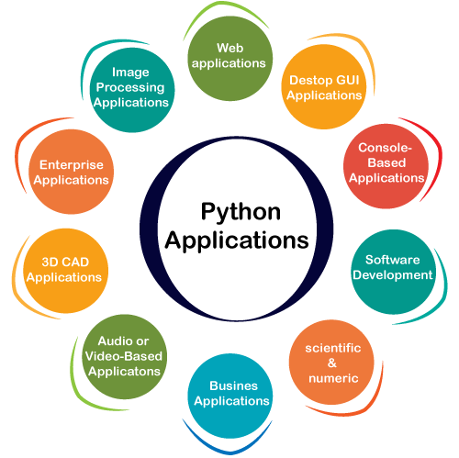
Applications areas of python (CO1)

Slide 49
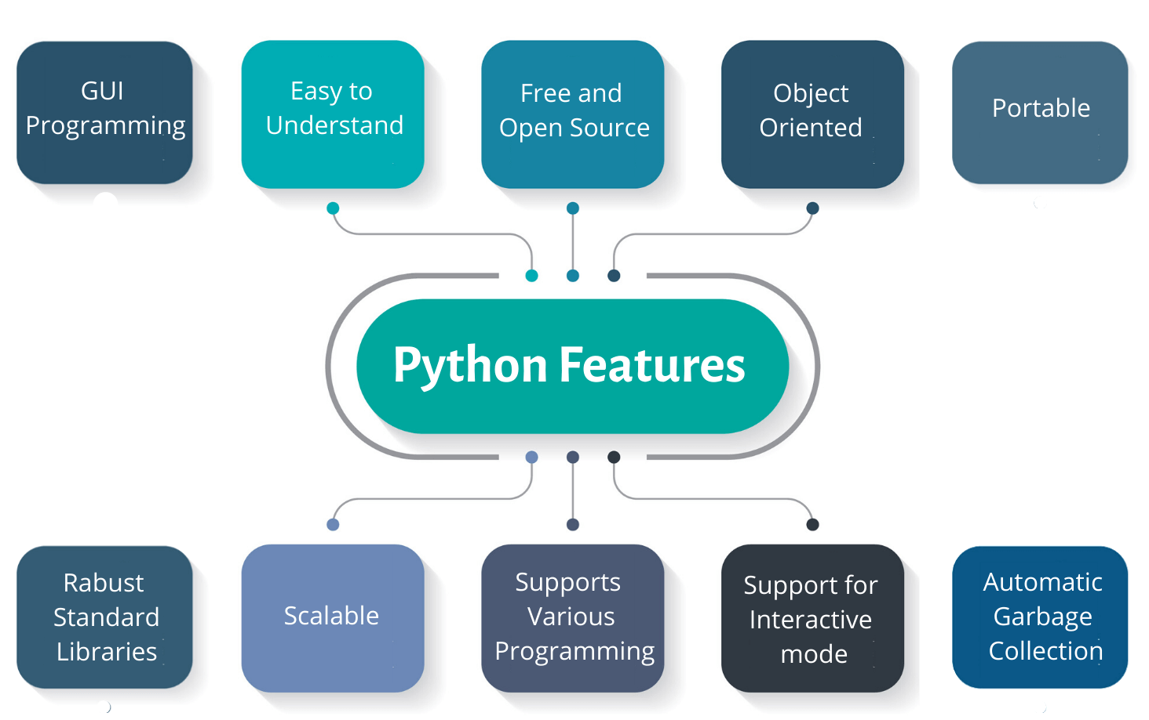
Features of Python (CO1)

Slide 50
Features of Python (CO1)
A simple language which is easier to learn.
Free and open-source.
Portability.
Extensible and Embeddable
easily combine pieces of C/C++ or other languages with Python code.
A high-level, interpreted language.
Large standard libraries to solve common tasks.

Slide 51
Features of Python (CO1)
Object-oriented
Everything in Python is an object.
Object oriented programming (OOP) helps to solve a complex problem intuitively.
Structure supports such concepts as polymorphism, operation overloading, and multiple inheritance.
It supports functional and structured programming methods as well as OOP.
It can be used as a scripting language or can be compiled to byte-code for building large applications.

Slide 52
Features of Python (CO1)
It supports automatic garbage collection.
Scalable
Python provides a better structure and support for large programs than shell scripting.
It can be easily integrated with C, C++, COM, ActiveX, CORBA, and Java.
Databases
Python provides interfaces to all major commercial databases.

Slide 53
Getting Python (CO1)
The most up-to-date and current source code, binaries, documentation, news, etc., is available on the official website of Python
https://www.python.org/
Python documentation can be downloaded from
https://www.python.org/doc/

Slide 54
The Programming Cycle for Python (CO1)
Python's development cycle is dramatically shorter than that of traditional languages.
In Python, there are no compile or link steps.
Python programs simply import modules at runtime and use the objects they contain.
Python programs run immediately after changes are made.
And in cases where dynamic module reloading can be used, it's even possible to change and reload parts of a running program without stopping it at all.

Slide 55
The Programming Cycle for Python (CO1)
Traditional Development Cycle
Python’s Development Cycle
Start the application
Start the application
Test behavior
Test behavior
Stop the application
Stop the application
Edit the program code
Python’s Development Cycle with Module Reloading
Edit the program code
Start the application
Recompile code
Test behavior
Relink the executable
Edit the program code

Slide 56

Python IDE (CO1)
The Jupyter Notebook is an open-source web application that allows to create and share documents that contain live code, equations, visualizations and narrative text.
Its Uses include data cleaning and transformation, numerical simulation, statistical modeling, data visualization, machine learning, and much more.
Download link as per OS version:
https://www.anaconda.com/products/individual-d
Download Procedure Link:
https://www.youtube.com/watch?v=kbTSj5xTgNc

Slide 57
Why Jupyter notebook is useful? (CO1)
It has the ability to display plots that are the output of running code cells.
Jupyter Notebooks support many programming languages like R, C++, and JavaScript, among many others.

Slide 58
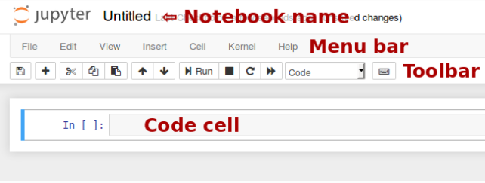
Notebook user interface (CO1)
To create a new notebook document, it will be presented with the notebook name, a menu bar, a toolbar and an empty code cell.

Slide 59
Notebook user interface cont…(CO1)
Notebook name: The name displayed at the top of the page, next to the Jupyter logo, reflects the name of the .ipynb file. Clicking on the notebook name brings up a dialog which allows you to rename it. Thus, renaming a notebook from “Untitled0” to “My first notebook” in the browser, renames the Untitled0.ipynb file to My first notebook.ipynb.
Menu bar: The menu bar presents different options that may be used to manipulate the way the notebook functions.
Toolbar: The tool bar gives a quick way of performing the most-used operations within the notebook, by clicking on an icon.
Code cell: the default type of cell; read on for an explanation of cells.

Slide 60
Keyboard shortcuts (CO1)
All actions in the notebook can be performed with the mouse, but keyboard shortcuts are also available for the most common ones. The essential shortcuts to remember are the following:
Shift-Enter: run the current cell, show any output, and jump to the next cell below. If Shift-Enter is invoked on the last cell, it makes a new cell below. This is equivalent to clicking the Cell, Run menu item, or the Play button in the toolbar.
Esc: Convert the cell into command mode.
Enter: Convert the cell into edit mode.
For the full list of available shortcuts, click Help, Keyboard Shortcuts in the notebook menus.

Slide 61




Python IDE (CO1)
Spyder
https://www.spyder-ide.org/
IDLE
https://docs.python.org/3/library/idle.html
Sublime Text 3
https://www.sublimetext.com/3
Jupyter
https://jupyter.org/install.html

Slide 62
Interacting with Python Programs (CO1)
Open the command prompt.
Write jupyter notebook in command prompt and then press enter key.
Jupyter notebook will be opened in link of laptop browser. For e.g., http://localhost:8888/tree this kind of link will open up.
Select the path you want to save the file.
Click on the new option on the right most corner and select python3 from cursor. Untitled notebook will open up, you can change up the name by selecting it.

Slide 63
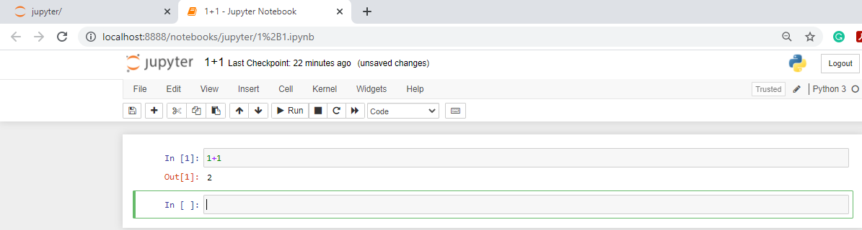
Elements of Python (CO1)
6. Click on the code cell write down the code 1+1 and then press shift + Enter from keyboard/run command from interface. Then check the output.

Slide 64
Elements of Python (CO1)
Elements of Python (CO1)

Slide 65
Topic Objective
The students will study the elements of Python like Keywords and Identifiers, Variables, Data types and Operators.

Slide 66
Prerequisite and Recap
Expression
Operators
Constant and variable

Slide 67
Elements of Python (CO1)
Keywords and Identifiers
Variables
Data types and type conversion
Operators in Python
Expressions in Python

Slide 68
Keywords (CO1)
Keywords are the reserved words in Python.
We cannot use a keyword as a variable name, function name or any other identifier. They are used to define the syntax and structure of the Python language.
In Python, keywords are case sensitive.
All the keywords except True, False and None are in lowercase, and they must be written as they are.
Example
and, as, assert, await, break, class, continue, def, del, elif, else, except, finally, for, global, if, import, in, is, lambda, not, or, pass, raise, return, try, while, with, yield

Slide 69
Identifiers (CO1)
An identifier is a name given to entities like class, functions, variables, etc. It helps to differentiate one entity from another.

Slide 70
Rules for writing Identifiers (CO1)
Identifiers can be a combination of letters in lowercase (a to z) or uppercase (A to Z) or digits (0 to 9) or an underscore _.
An identifier cannot start with a digit.
Keywords cannot be used as identifiers.
Cannot use special symbols like !, @, #, $, % etc. in identifier.
An identifier can be of any length.

Slide 71
Variables (CO1)
A variable is a location in memory used to store some data (value).
Unique names are given to them to differentiate between different memory locations.
No need to declare a variable before using it. The declaration happens automatically when a value is assigned to a variable.
The Assignment operator (=) is used to assign values to variables.

Slide 72
Variables (CO1)
The operand to the left of the = operator is the name of the variable and the operand to the right of the = operator is the value stored in the variable.
For example
>>> num = 347 # An integer assignment
>>> x = 45.89 # A floating point
>>> name = “Aman" # A string

Slide 73
Multiple Assignment in Variables (CO1)
A single value may be assigned to several variables simultaneously.
For example
>>> a = b = c = 1
Here, an integer object is created with the value 1, and all three variables are assigned to the same memory location.
It also allows to assign multiple objects to multiple variables.
For example −
>>> a, b, c = 23, 29.45, “Ram”
Here, two integer objects with values 23 and 29.45 are assigned to variables a and b respectively, and one string object with the value “Ram" is assigned to the variable c.

Slide 74
Data types (CO1)
Every value in Python has a datatype, that are used to define the operations possible on them and the storage method for each of them.
Since everything is an object in Python programming, data types are classes and variables are instance (object) of these classes

Slide 75
Standard Data types (CO1)
Data Types | Keyword
Text Type | str
Numeric Types | int, float, complex
Sequence Types | list, tuple, range
Mapping Type | dict
Set Types | set
Boolean Types | bool
Binary Types | bytes

Slide 76
Numbers (CO1)
They store numeric values. Number objects are created when a value is assigned to them. For ex:
>>> var1 = 1
>>> var2 = 10
They can be deleted the reference to a number object by using the del statement. The syntax of the del statement is
del var1[,var2[,var3[....,varN]]]]
A single object or multiple objects can be deleted by using the del statement. For example
>>> del var
>>> del var_a, var_b

Slide 77
Types of Number Types (CO1)
int (signed integers)
float (floating point real values)
complex (complex numbers)

Slide 78
Examples of Number Types (CO1)
int | float | complex
10 | 0.0 | 3.14j
100 | 15.20 | 45.j
-786 | -21.9 | 9.322e-36j
0o80 | 32.3+e18 | .876j
-0o490 | -90 | -.6545+0J
-0x260 | -32.54E100 | 3e+26J

Slide 79
Strings (CO1)
Strings in Python are identified as a contiguous set of characters represented in the quotation marks.
Python allows for either pairs of single or double quotes.
Subsets of strings can be taken using the slice operator ([ ] and [:] ) with indexes starting at 0 in the beginning of the string and working their way from -1 at the end.
The plus (+) sign is the string concatenation operator and the asterisk (*) is the repetition operator.

Slide 80
Strings (CO1)
For example
>>> str = ‘Hello World!’
>>> print(str) # Prints complete string
>>> print(str[0]) # Prints first character of the string
>>> print(str[2:5]) # Prints characters starting from 3rd to 5th
>>> print(str[2:]) # Prints string starting from 3rd character
>>> print(str * 2) # Prints string two times
>>> print(str + ‘TEST’) # Prints concatenated string

Slide 81
Slicing Strings (CO1)
Slicing
A range of characters can be returned by using the slice syntax.
Specify the start index and the end index, separated by a colon, to return a part of the string.
Example
Get the characters from position 2 to position 5 (not included):
Program
b = "Hello, World!" print(b[2:5])
Program Output
llo

Slide 82
Program to demonstrate slicing of Strings (CO1)
# String slicing
String ='ASTRING'
# Using slice constructor
s1 = slice(3)
s2 = slice(1, 5, 2)
s3 = slice(-1, -12, -2)
print("String slicing")
print(String[s1])
print(String[s2])
print(String[s3])

Slide 83
Output of slicing of Strings (CO1)
Output:
String slicing
AST
SR
GITA

Slide 84
Lists (CO1)
A List is an ordered sequence of item, It contains items separated by commas and enclosed within square brackets ([]).
To some extent, lists are like arrays in C. One difference between them is that all the items belonging to a list can be of different data type.
Declaring a list is straight forward. Items separated by commas are enclosed within brackets [ ].

Slide 85
Lists (CO1)
>>> a = [1, 2.2, 'python']
The values stored in a list can be accessed using the slice operator ([ ] and [:]) with indexes starting at 0 in the beginning of the list.
The plus (+) sign is the list concatenation operator, and the asterisk (*) is the repetition operator.

Slide 86
Lists (CO1)
>>> list = [ 'abcd', 786 , 2.23, 'john', 70.2 ]
>>> tinylist = [123, 'john’]
>>> print(list) # Prints complete list
>>> print(list[0]) # Prints first element of the list
>>> print(list[1:3]) # Prints elements starting from 2nd till 3rd
>>> print(list[2:]) # Prints elements starting from 3rd element
>>> print(list * 2) # Prints list two times
>>> print(list + tinylist) # Prints concatenated lists

Slide 87
Tuple (CO1)
A tuple is similar to the list. A tuple consists of several values separated by commas. Unlike lists, however, tuples are enclosed within parentheses.
The main differences between lists and tuples are: Lists are enclosed in brackets ( [ ] ) and their elements and size can be changed, while tuples are enclosed in parentheses ( ( ) ) and cannot be updated.
Tuples can be thought of as read-only lists.
The only difference is that tuples are immutable. Tuples once created cannot be modified.
Tuples are used to write-protect data and are usually faster than list as it cannot change dynamically.

Slide 88
Tuple (CO1)
>>> tuple = ( 'abcd', 786 , 2.23, 'john', 70.2 )
>>> tinytuple = (123, 'john’)
>>> print(tuple) # Prints complete tuple
>>> print(tuple[0]) # Prints first element of the tuple
>>> print(tuple[1:3]) # Prints elements starting from 2nd till 3rd
>>> print(tuple[2:]) # Prints elements starting from 3rd element
>>> print(tuple * 2) # Prints tuple two times
>>> print(tuple + tinytuple) # Prints concatenated tuples

Slide 89
Set (CO1)
Set is an unordered collection of unique items.
Set is defined by values separated by comma inside braces { }.
Items in a set are not ordered.
Set operations can be performed like union, intersection on two sets. Set have unique values. They eliminate duplicates.
indexing has no meaning as set are unordered collection. Hence the slicing operator [] does not work.
For example
>>>a = {1,2,2,3,3,3}
>>> a
{1, 2, 3}

Slide 90
Dictionary (CO1)
Dictionary is an unordered collection of key-value pairs.
It is generally used when we have a huge amount of data.
Dictionaries are optimized for retrieving data. It is must to know the key to retrieve the value.
A dictionary key can be almost any Python type but are usually numbers or strings. Values, on the other hand, can be any arbitrary Python object.
Dictionaries are defined within braces {} with each item being a pair in the form key: value. Key and value can be of any type.
For example
>>> d = {1:'value','key':2}
>>> type(d)
<class 'dict'>

Slide 91
Type conversion (CO1)
The process of converting the value of one data type (integer, string, float, etc.) to another data type is called type conversion.
Python has two types of type conversion.
Implicit Type Conversion
Explicit Type Conversion

Slide 92
Implicit Type conversion (CO1)
Python automatically converts one data type to another data type without any user involvement.
It always converts smaller data types to larger data types to avoid the loss of data.
Example
>>> a = 4
>>> b = 2.3
>>> c = a + b
In above example, data type of a and b are int and float, respectively. Data type of c will be float and its value is 6.3

Slide 93
Explicit Type conversion (CO1)
In Explicit Type Conversion, users convert the data type of an object to required data type.
The predefined functions like int(), float(), str() are used to perform explicit type conversion.
This type of conversion is also called typecasting because the user casts/changes the data type of the objects.
Syntax
<datatype>(expression)
Example
>>> a = 2.6
>>> c = int(a)

Slide 94
Function of type conversion (CO1)
Function | Description
int(x) | Convert x to an integer
float(x) | Convert x to a float number
str(x) | Convert x to a string
tuple(x) | Convert x to a tuple
list(x) | Convert x to a list
set(x) | Convert x to a set
ord(x) | Convert x to ASCII code
bin(x) | Convert x to a binary
oct(x) | Convert x to an octal
hex(x) | Convert x to a hexadecimal
chr(x) | Convert x to a character

Slide 95
Operators in Python (CO1)
Python language supports the following types of operators.
Arithmetic Operators
Relational Operators
Assignment Operators
Logical Operators
Bitwise Operators
Membership Operators
Identity Operators

Slide 96
Arithmetic Operators (CO1)
Operator | Description | Example (a=5, b=3)
+ | Adds values on either side of the operator. | a + b = 8
- | Subtracts right hand operand from left hand operand. | a – b = 2
* | Multiplies values on either side of the operator | a * b = 15
/ | Divides left hand operand by right hand operand | a / b = 1.6667
% | Divides left hand operand by right hand operand and | a % b = 2
** | Performs exponential (power) calculation on operators | a**b =5³= 125
// | The division of operands where the result is the quotient in which the digits after the decimal point are removed. | a//b=1

Slide 97
Relational Operators (CO1)
Operator | Description | Example a=5, b=3
== | If the values of two operands are equal, then the condition becomes true | a == b is not true.
!= | If values of two operands are not equal, then condition becomes true. | a!=b is true
> | If the value of left operand is greater than the value of right operand, then condition becomes true. | a > b is true
< | If the value of left operand is less than the value of right operand, then condition becomes true. | a < b is not true
>= | If the value of left operand is greater than or equal to the value of right operand, then condition becomes true. | a >= b is true
<= | If the value of left operand is less than or equal to the value of right operand, then condition becomes true. | a <= b is not true

Slide 98
Assignment Operators (CO1)
Operator | Description
= | a = b Assigns values from right side operands(b) to left side operand (a)
+= | a+=b is same as a = a + b It adds right operand to the left operand and assign the result to left operand
-= | a-=b is same as a = a - b It subtracts right operand from the left operand and assign the result to left operand
*= | a*=b is same as a = a * b It multiplies right operand with the left operand and assign the result to left operand
/= | a/=b is same as a = a / b It divides left operand with the right operand and assign the result to left operand

Slide 99
Assignment Operators (CO1)
Operator | Description
%= | a%=b is same as a = a % b It takes modulus using two operands and assign the result to left operand
**= | a**=b is same as a = a ** b Performs exponential (power) calculation on operators and assign value to the left operand
//= | a//=b is same as a = a //b It performs floor division on operators and assign value to the left operand

Slide 100
Logical Operators (CO1)
Logical operators are the and, or, not operators.
Operator | Description
and | True if both the operands are true
or | True if either of the operands is true
not | True if operand is false (complements the operand)

Slide 101
Logical Operators (CO1)
a | b | a and b | a or b | not a
True | True | True | True | False
True | False | False | True | False
False | True | False | True | True
False | False | False | False | True

Slide 102
Bitwise Operators (CO1)
Bitwise operators manipulate the data at bit level.
These are applicable on integer values.
Types
& (Bitwise and operator)
| (Bitwise or operator)
^ (Bitwise XOR operator)
~ (Bitwise one’s complement operator)
<< (Bitwise left-shift operator)
>> (Bitwise right-shift operator)

Slide 103
Bitwise Operators (CO1)
a | b | a & b | a | b | a ^ b | ~a
0 | 0 | 0 | 0 | 0 | 1
0 | 1 | 0 | 1 | 1 | 1
1 | 0 | 0 | 1 | 1 | 0
1 | 1 | 1 | 1 | 0 | 0

Slide 104
Bitwise Operators (CO1)
Operator | Let a = (92)₁₀ =(0101 1100)₂ and b = (14)₁₀ = (0000 1110)₂
& | c = (a & b) = 92 & 14 | 0101 1100 & 0000 1110 -------------------- 0000 1100 = (12)₁₀
I | c = (a | b) = 92 | 14 | 0101 1100 | 0000 1110 -------------------- 0101 1110 = (94)₁₀
^ | c = (a ^ b) = 92 | 14 | 0101 1100 ^ 0000 1110 -------------------- 0101 0010 = (82)₁₀

Slide 105
Bitwise Operators (CO1)
Operator | Let a = (92)₁₀ =(0101 1100)₂ and b = (14)₁₀ = (0000 1110)₂
~ | c = ~a = ~92 | c = ~(0101 1100) = 1010 0011
<< | c = a<< 1 = 46<< 1 | C = 00101 110 << 1 = 01011100 = (92)₁₀
>> | c = a >> 2 = 92>> 2 | C = 0101 1100 >> 2 = 0001 0111 = (23)₁₀

Slide 106
Membership Operators (CO1)
in and not in are the membership operators in Python.
They are used to test whether a value or variable is found in a sequence (string, list, tuple, set and dictionary).
In a dictionary, we can only test for presence of key, not the value.
Operator | Description | Example x = {2,3,5} | Result
in | True if value/variable is found in the sequence | 5 in x | True
not in | True if value/variable is not found in the sequence | 5 not in x | False

Slide 107
Identity Operators (CO1)
Identity operators compare the memory locations of two objects.
is and is not are the identity operators in Python.
They are used to check if two values (or variables) are located on the same part of the memory.
Two variables that are equal does not imply that they are identical.
Operator | Description | Example a = ‘Hello’ b = ‘Hello’ | Result
is | True if the operands are identical (refer to the same object) | a is b | True
is not | True if the operands are not identical (do not refer to the same object) | a is not b | False

Slide 108
Operator Precedence and associativity(CO1)
When an expression contains two or more than two operators, then it is evaluated based on operator precedence and associativity.
Each operator of same precedence is grouped in same level and operator of higher precedence is evaluated first.
Two or more operators having equal precedence are evaluated either left-to-right(LTR) or right-to-left(RTL) based on their associativity.

Slide 109
Operator Precedence and associativity(CO1)
Operator | Description
() | Parenthesis
** | Exponentiation
~,+,- | Unary operators
*,/,//,% | Arithmetic multiply, division, floor and modulo division
+, - | Addition and subtraction
>>,<< | Bitwise left and right shift operator
& | Bitwise and operator
^ | Bitwise Ex-or operator
| | Bitwise or operator

Slide 110
Operator Precedence and associativity(CO1)
Operator | Description
<=,>=,<,> | Relational inequality operators
==, != | Equal and not equal operators
=,*=,/=,//=,%=,+=,-=,**=,&= | Assignment operators
is, is not | Identity operators
in, not in | Membership operators
not | Logical not operator
and | Logical and operator
or | Logical or operator

Slide 111
Expressions in Python (CO1)
Expressions are representations of value.
They are different from statement in the fact that statements do something while expressions are representation of value.
Python expression contains identifiers, literals, and operators.
For Example
x = a*b + c/d –f is an expression.

Slide 112
Classes (CO1)
The class can be defined as a collection of objects. It is a logical entity that has some specific attributes and methods. For example: if you have an employee class, then it should contain an attribute and method, i.e. an email id, name, age, salary, etc.
Syntax
class ClassName:
<statement-1>
.
.
<statement-N>

Slide 113
Object (CO1)
The object is an entity that has state and behavior. It may be any real-world object like the mouse, keyboard, chair, table, pen, etc.
Everything in Python is an object, and almost everything has attributes and methods. All functions have a built-in attribute __doc__, which returns the docstring defined in the function source code.
When we define a class, it needs to create an object to allocate the memory. Consider the following example.

Slide 114
Example of Object (CO1)
class car:
def __init__(self,modelname, year):
self.modelname = modelname
self.year = year
def display(self):
print(self.modelname,self.year)
c1 = car("Toyota", 2016)
c1.display()

Slide 115
Output of example (CO1)
Toyota 2016

Slide 116
Python Constructor(CO1)
A constructor is a special type of method (function) which is used to initialize the instance members of the class.
In C++ or Java, the constructor has the same name as its class, but it treats constructor differently in Python. It is used to create an object.
Constructors can be of two types.
Parameterized Constructor
Non-parameterized Constructor
Constructor definition is executed when we create the object of this class. Constructors also verify that there are enough resources for the object to perform any start-up task.

Slide 117
Creating Python Constructor(CO1)
In Python, the method the __init__() simulates the constructor of the class. This method is called when the class is instantiated. It accepts the self-keyword as a first argument which allows accessing the attributes or method of the class.
We can pass any number of arguments at the time of creating the class object, depending upon the __init__() definition. It is mostly used to initialize the class attributes. Every class must have a constructor, even if it simply relies on the default constructor.
Consider the following example to initialize the Employee class attributes.

Slide 118
Example Python Constructor(CO1)
class Employee:
def __init__(self, name, id):
self.id = id
self.name = name
def display(self):
print("ID: %d \nName: %s" % (self.id, self.name))
emp1 = Employee("John", 101)
emp2 = Employee("David", 102)
# accessing display() method to print employee 1 information
emp1.display()
# accessing display() method to print employee 2 information
emp2.display()

Slide 119
Output of example(CO1)
ID: 101
Name: John
ID: 102
Name: David

Slide 120
Python Non-Parameterized Constructor (CO1)
The non-parameterized constructor uses when we do not want to manipulate the value or the constructor that has only self as an argument.
Example:
class Student:
# Constructor - non parameterized
def __init__(self):
print("This is non parametrized constructor")
def show(self,name):
print("Hello",name)
student = Student()
student.show("John")

Slide 121
Output of Non-Parameterized Constructor (CO1)
This is non parametrized constructor
Hello John

Slide 122
Python Parameterized Constructor (CO1)
Constructor with parameters is known as parameterized constructor.
The parameterized constructor takes its first argument as a reference to the instance being constructed known as self and the rest of the arguments are provided by the programmer.

Slide 123
Python Parameterized Constructor (CO1)
Example:
class Student:
# Constructor - parameterized
def __init__(self, name):
print("This is parametrized constructor")
self.name = name
def show(self):
print("Hello",self.name)
student = Student("John")
student.show()
Output:
This is parametrized constructor
Hello John

Slide 124
Python Default Constructor (CO1)
The default constructor is a simple constructor which doesn’t accept any arguments.
Its definition has only one argument which is a reference to the instance being constructed.

Slide 125
Faculty Video Links, You tube & NPTEL Video Links and Online Courses Details
Youtube/other Video Links
Evolution of Computer
https://youtu.be/OQax5NF5aEw
Application of Computers
https://youtu.be/ac7T3ocg9gk
Code of Conduct
https://youtu.be/txNEiGwVtUA
Algorithm and flowchart
https://youtu.be/RwnY_mJ6ras
Introduction to Python
https://youtu.be/xxeBb7OyKXY

Slide 126
Daily Quiz
In Python, ‘Hello’, is the same as “Hello”
True
False
_________Operator is used to multiply numbers.
*

Slide 127
Weekly Assignment 1.1
Give classification of computers. (CO1)
Explain memory hierarchy with the help of a diagram. (CO1)
What is a digital computer? Draw the block diagram of a digital computer and explain its each component. (CO1)
Explain the need of cache memory in a computer system. (CO1)

Slide 128
Weekly Assignment 1.1
Define the term software and hardware. Briefly explain system software and application software with at least one example of each. (CO1)
What is operating system? List functions and types of operating system. (CO1)
Define algorithm. Write Properties of an algorithm. (CO1)
Write an algorithm and draw a flow-chart to swap two numbers without using third variable. (CO1)

Slide 129
Weekly Assignment 1.1
Write an algorithm and draw a flow-chart to check whether given year is a leap year or not. (CO1)
Write an algorithm and draw a flow-chart to compute factorial of a given number. (CO1)
Write an algorithm and draw a flow-chart to check whether the given number is an armstrong number or not. (CO1)
Write an Algorithm and design a flow-chart to compute prime factors of the given number. (CO1)

Slide 130
Weekly Assignment 1.2
What is Python? What are the benefits of using Python? (CO1)
Discuss about feature and application area of python (CO1)
What is PEP 8? How is memory managed in Python? (CO1)
Explain types of operators used in python. (CO1)

Slide 131
Weekly Assignment 1.2
What is class and objects? Explain role of constructor. (CO1)
What do you mean by tokens? Explain different elements of python. (CO1)
Explain operator precedence and associativity with suitable example. (CO1)
Write short notes on “Ethics and IT policy in a company”. (CO1)
Explain the rules of naming identifier in Python. (CO1)
Write a python program to compute the surface area and volume of cone. (CO1)
Write a Python Program to swap values of two variable using comma(,) operator. (CO1)

Slide 132
MCQs
What is the correct file extension for Python files?
.pyt
.py
.pt
.pyth
What is the output for −
'python ' [-3]?
'o'
't'
'h'
Negative index error.

Slide 133
MCQs
How do you create a variable with the numeric value 5?
x = 5
x = int(5)
Both option (a) and (b) are correct
No option is correct
Which one is NOT a legal variable name?
My_var
My-var
_Myvar
Myvar

Slide 134
MCQs
Which operator can be used to compare two values?
<>
><
==
=
Which one is a legal identifier?
ab#cd
abc
S.I
Area of circle

Slide 135
MCQs
Which of these collections defines a SET?
{1, 2, 3, 4}
{‘1’:’12’,’2’:’45’}
(1,2,3,4)
[1,2,3,4]

Slide 136
Old Question Papers
In Python what is slicing? [NIET Autonomous 2020-2021(odd), 1 marks]
Write name of any two Python Editors(IDE)? [NIET Autonomous 2020-2021(odd), 1 marks]
How is Python an interpreted language? [NIET Autonomous 2020-2021(odd), 1 marks]
What does [::-1] do? [NIET Autonomous 2020-2021(odd), 1 marks]
What is __init__? [NIET Autonomous 2020-2021(odd), 1 marks]

Slide 137
Old Question Papers
What is negative index in Python? [NIET Autonomous 2020-2021(odd), 1 marks]
Define floor division with example? [NIET Autonomous 2020-2021(odd), 2 marks]
Define the Programming Cycle for Python? [NIET Autonomous 2020-2021(odd), 2 marks]
Discuss format specifiers and escape sequences with examples. [NIET Autonomous 2020-2021(odd), 6 marks]
Explain Ethics and IT policy in company. [NIET Autonomous 2020-2021(odd), 10 marks]

Slide 138
Old Question Papers
Explain the following:
Implicit and Explicit type-casting
Rules for naming an Identifier [NIET Autonomous 2020-2021(odd), 10 marks]
What is the difference between list and tuples?
[AKTU 2019-2020(odd), 2 marks]
In some languages, every statement ends with semicolon(;). What happens if you put a semi-colon at the end of a Python statement? [AKTU 2019-2020(odd), 2 marks]

Slide 139
Old Question Papers
Mention five benefits of using Python.
[AKTU 2019-2020(odd), 2 marks]
How is Python an interpreted language?
[AKTU 2019-2020(odd), 2 marks]
What type of language is Python ?
[AKTU 2019-2020(odd), 2 marks]
Define floor division with example.
[AKTU 2019-2020(odd), 2 marks]

Slide 140
Old Question Papers
Write short notes with example: The Programming cycle for Python, Elements of Python, Type conversion in Python, operator precedence and Boolean expression.
[AKTU 2019-2020(odd), 10 marks]

Slide 141
Expected Questions for University Exam
Define operator. Explain various types of operators in Python with suitable example.
Explain standard data types in Python.
Explain Programming cycle of Python.
Explain the type conversion in Python.
Names some frequently used Python IDEs.

Slide 142
Summary
Introduction to computer system
Algorithms and flowcharts
Ethics and IT policy in company
The Programming Cycle for Python
Python IDE
Features of Python
Elements of Python

Slide 143
References
Allen B. Downey, “Think Python: How to Think Like a Computer Scientist”, 2nd edition, Updated for Python 3, Shroff/O‘Reilly Publishers, 2016.
Robert Sedgewick, Kevin Wayne, Robert Dondero, “Introduction to Programming in Python: An Inter-disciplinary Approach” , Pearson India Education Services Pvt. Ltd., 2016.
Paul Barry, “Head First: A Brain Friendly Guide” O’Reilly publisher.
Reema Thareja, “Python Programming: Using Problem Solving Approach” 2nd Edition, Oxford University Press publisher.
Guido van Rossum and Fred L. Drake Jr, “An Introduction to Python”, Revised and updated for Python 3.2, Network Theory Ltd., 2011.

Slide 144
THANK YOU

